Slide 1
Computer Principles for Programmers
IT Projects, IT Jobs, and Project Management

Slide 2
Quiz
This was the last one.

Slide 3
News of the Week

Slide 4
Agenda
Lecture:
Tech Careers
What is “Project Management?”
What are some typical “IT Projects?”
What does a Project Manager do?
Software Development Life Cycle
Project Management Processes: Initiation, Planning, Executing, Controlling, Closing.
Advantages of Project Management
What is Project Management Certification?

Slide 5
Agenda (Cont’d)
Activity:
An activity to work on project management processes

Slide 6
Tech careers in 2017
Position | Salary 25th% | Salary 75th%
Developer: Java/C# Web .NET mobile | $65,000 | $110,000
Quality Assurance Analyst | $50,000 | $90,000
Business Systems Analyst | $71,000 | $129,000
Database, SQL | $60,000 | $108,000
Project Manager PMP, Agile, Scrum | $85,000 | $147,000
Growth Industries
Healthcare, FinTech,
Robotics in Manufacturing
Digital Transformation (DX)
Mobile Developers, DevOps
Technologies: AI, blockchain, VR/AR, 5G, 3D printing
Analytics, Big Data, Cloud Computing, Security, IoT
Notes:
https://www.ic.gc.ca/eic/site/ict-tic.nsf/eng/home
http://itac.ca/our-industry-our-profile/
https://www.itactalent.ca/wp-content/uploads/2014/06/ICT-%E2%80%93-The-Engine-of-Growth-in-Canada-%E2%80%93-Infographic.jpg
https://globalnews.ca/news/3417919/the-10-best-jobs-of-2017-in-canada-according-to-indeed-ca/
https://shawglobalnews.files.wordpress.com/2017/05/topjobscanada-indeed.jpg?quality=70&strip=all&strip=all
FinTech: https://www.theglobeandmail.com/business/commentary/article-weve-got-to-maximize-opportunities-and-minimize-risks-in-fintech/
https://www.jvstoronto.org/blog/job-in-demand-the-growing-information-communications-and-technology-sector-in-canada/
https://www.ictc-ctic.ca/wp-content/uploads/2017/07/ICTC_Outlook-2021-ENG-Final.pdf
Continuing Tech areas: social, mobile, apps, analytics and cloud technologies under Internet of Things (IoT)
Highest demand for skilled workers in the digital economy:
virtual reality (VR) and augmented reality (AR),
fifth generation (5G) mobile technology, three-dimensional (3D) printing,
Blockchain, and
Artificial intelligence (AI).
https://www.randstad.ca/hot-jobs/technology-jobs/technology-jobs-in-toronto/
https://www.roberthalf.ca/en/salary-guide/technology
Making up approximately 7% of the economy, Canada’s tech industry boasts 488,000 IT professionals
https://www.randstad.ca/hot-jobs/technology-jobs-in-demand/#titles
innovative industries such as advanced manufacturing, agri-food, clean technology, digital technology, health/biosciences and clean resources, as well as infrastructure and transportation. This also include "Fintech" Finance Technology, or companies that use innovative technology to revamp everything from banking to fraud security.
These initiatives require a range of skills including project managers.
http://www.theglobeandmail.com/report-on-business/canadian-fintech-companies-shine-as-venture-capital-investments-near-record/article33476692/

Slide 7
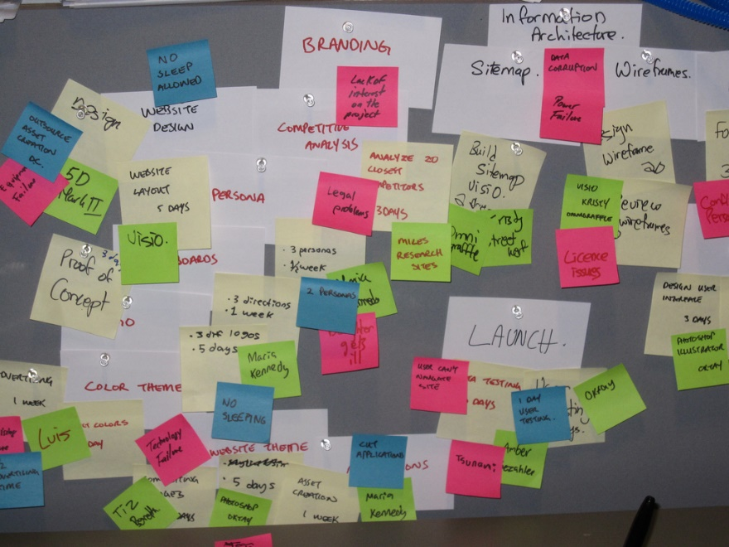
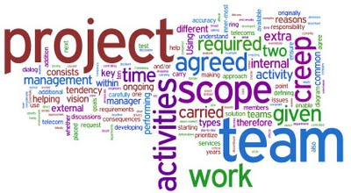
PROJECT
Business Systems Analysis – What's the problem?
System Development – What's the solution?
Project Management – Make it happen!
Notes:
Cost effective software delivered in a timely manner needs good analysis, good design, and good management. Why? If it costs $1 to identify a business requirement at the beginning of a project, it costs $100+ to add it after Going Live. The $1 cost is good management, the $100+ is bad management.
We had better know what we are doing. “good IT is expensive and bad IT is even more expensive”

Slide 8
What is “Project Management?”
…something employers want you to know!
Programming is just one aspect of creating a solution.
IT Project Mgmt is responsible for the whole solution.
"Project management is the application of knowledge, skills, tools and techniques to project activities to meet project requirements." -- Project Management Body of Knowledge (PMBOK) Guide from pmi.org
Notes:
The School of ICT has Industry Advisory Committees who advise us on what they want to see in our CPD & CPA graduates. Some of the technical skill sets change over time but they always ask that our graduates know about Project Management.
Project management is the application of knowledge, skills, tools and techniques to project activities to meet project requirements.
Project Management is the “discipline of initiating, planning, executing, controlling, and closing” the work of a team “to achieve specific goals and meet specific success criteria.”
Scope Management includes the processes required to ensure that the project includes all the work required, and only the work required, to complete the project successfully. Managing the project scope is primarily concerned with defining and controlling what is and is not included in the project.

Slide 9
Scale of Projects
Manhattan Project - first managed project
$2 billion budget ~$27 billion in 2017 dollars
Project Manager, Technical Manager, and 130,000 others.
Notes:
https://en.wikipedia.org/wiki/Manhattan_Project

Slide 10
Scale of Projects
Liberal Government March 2017 & 2018 budgets
$125-million Pan-Canadian Artificial Intelligence Strategy
$950 million for Innovation Clusters over five years.
Phoenix Pay: $5.7M → $185M → $307M + $659M + $16M 2011 2016 2017 2018-24 2018-19 software est swr actual total costs future costs research Go Live April, 2016 new system
Phoenix scope: 300,000 employees, 34 HR/payroll systems, 105 contracts, 80,000 different pay rules, 1,000 bugs by January, 2017; more open tickets/issues than employees.
Notes:
http://www.cbc.ca/news/canada/ottawa/phoenix-ibm-contract-union-pay-government-1.4295827
The relatively straightforward task of installing PeopleSoft HR software for a few government agencies morphed into a massive project dubbed Phoenix, which is detailed in a 1,700-page contract that has been revised some three dozen times, CBC reported at http://www.cbc.ca/news/canada/ottawa/phoenix-ibm-contract-union-pay-government-1.4295827
The IBM contract started at $5.7 million for the first stage of the deal with the Cdn federal gov't in 2011, i.e. install PeopleSoft HR package, but after 39 amendments over six years, the deal is worth $185 million. (scope creep!)
http://www.cbc.ca/news/canada/ottawa/phoenix-government-psac-payroll-1.4300801
https://www.itworldcanada.com/blog/phoenix-payroll-report-by-michael-wernick-the-clerk-of-the-privy-council/385370
http://thechronicleherald.ca/canada/1522576-a-by-the-numbers-look-at-the-auditor-generals-report-on-the-phoenix-pay-system
The implementation costs of a payroll system that was delayed and has never worked properly actually came in under budget at a cost of $307 million, the federal government says. That figure is $2 million less than what the government projected several years ago — but it doesn't include the multimillions earmarked for fixing Phoenix.
http://www.oag-bvg.gc.ca/internet/English/parl_oag_201711_01_e_42666.html
Complexity:
300,000 federal public servants were consolidated into a single payroll system
their pay, benefit plans and pension contributions are governed by 105 collective (union) agreements
administered by 34 HR/payroll systems.
80,000: Different pay rules that guide those payments.
200: Custom additions to Phoenix to handle those 80,000 rules.
Imagine the ETL from those dozens of payrolls systems to Extract, Translate, and Load the phoenix system.
Imagine the training necessary for users to be able to configure the 80,000 rules for each of 300,000 employees.
http://www.cbc.ca/news/canada/ottawa/phoenix-by-the-numbers-31-000-more-phoenix-cases-1.4425431 <– see infographic there.
http://calleam.com/WTPF/?tag=examples-of-failed-projects
http://calleam.com/WTPF/?p=8336
http://www.cbc.ca/news/canada/ottawa/phoenix-payroll-problems-ibm-1.3770947
Go Live was Feb 2016.
Many of the 300,000 public servants have been incorrectly paid. Some have received too little, some too much and some have received no pay at all…for MONTHS.
“you know your project is in trouble when … the Prime Minister has to address the issue”
There were more than 1,000 bug reports by January 2017
shortly after launch, as many as 7,000 calls per day were received by a help desk sized for 2,200 calls per day. By July 2016, there were 82,000 outstanding cases of errors affecting 1/4 of all public servants. Nearly two years post-implementation, officials have had to expand their payroll support staff from 550 heads to more than 1,500 to cope. Ironically, an initial justification for the project was to save on these support staff.
Contributing factors as reported in the press: Failure to provide users with adequate training . Failure to cleanse data prior to migration to the new system. Software quality issues. Failure to have sufficient resources on hand to address launch glitches and problems.
IBM Canada has stated: "The vast majority of the issues in this implementation are process and data issues, not technical system issues."
These are all project management issues.
http://www.cbc.ca/news/canada/ottawa/phoenix-audit-missing-data-not-full-picture-1.4413112
https://www.theglobeandmail.com/news/politics/2018-federal-budget-highlights/article38116231/
http://www.cbc.ca/news/canada/ottawa/phoenix-eventually-replaced-federal-budget-2018-1.4554399
PHOENIX PAY SYSTEM
The federal government announced in the 2018 budget that it will eventually move away from its problem-plagued Phoenix pay system - which has overpaid, underpaid or completely failed to pay tens of thousands of public servants - and invest $16-million over two years to develop a new pay system.
In the meantime, Ottawa is planning to continue to invest in Phoenix for years to come. The budget proposes the government invest $431.4-million over six years to deal with ongoing issues. The money will help hire more staff at the Phoenix pay centre in Miramichi, N.B., and satellite offices across Canada, as well as additional payroll support staff in government departments.
http://brookfieldinstitute.ca/2017/03/22/10-things-canadas-innovators-entrepreneurs-should-know-budget/
http://business.financialpost.com/fp-tech-desk/federal-budget-2017-ottawa-aims-to-make-canada-digital-leader-with-ai-strategy-support-for-fintech-entrepreneurs
http://www.theglobeandmail.com/report-on-business/rob-commentary/its-time-for-canada-to-invest-in-developing-artificial-intelligence/article34429736/
https://ipolitics.ca/2017/03/22/budget-outlines-plan-to-curb-canadas-innovation-headache/
https://www.cbc.ca/news/canada/ottawa/phoenix-cost-more-than-one-billion-dollars-1.4594115

Slide 11
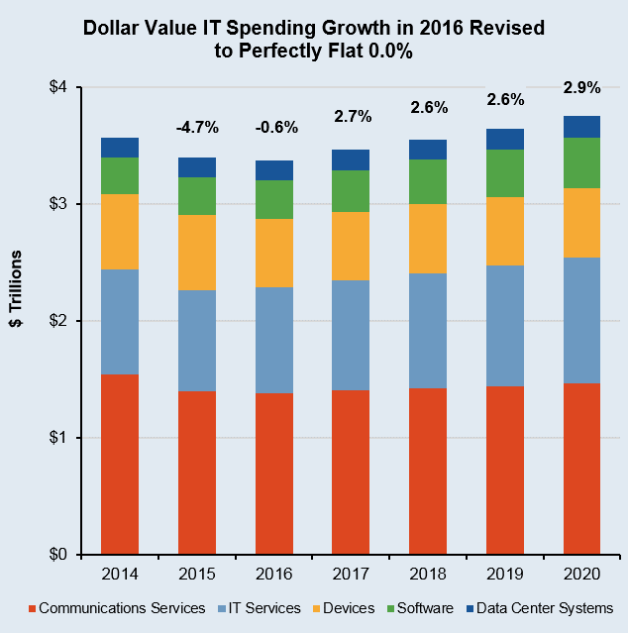
Worldwide IT Spending
Garnter Inc.
Notes:
Worldwide IT spending is projected to total $3.5 trillion in 2017, a 2.7 percent increase from 2016, according to Gartner, Inc. The worldwide IT services market is forecast to grow 4.2 percent in 2017. Buyer investments in digital business, intelligent automation, and services optimization and innovation continue to drive growth in the market. http://www.gartner.com/newsroom/id/3568917
The largest region for total IT spend in 2017 remains North America, with USD$1.19 trillion. However, the fastest-growing region is emerging Asia/Pacific, with 2017 constant-currency growth of 5.9% (revised up 0.4% from the 3Q16 update). The next-best region for growth is sub-Saharan Africa, with 2017 constant-currency growth of 5.2%, up 0.5% from 3Q16.
USD$3.464 trillion world-wide spending USD$900B in IT Services and USD$333B in Enterprise Software. Those last two areas are us in CPD/CPA. They are also the areas showing the strongest growth in the last few years historically and projected.
Seneca Library has access to the Gartner database. http://library.senecacollege.ca/res/Gartner.html
We had better know what we are doing. “good IT is expensive and bad IT is even more expensive”
http://calleam.com/WTPF/?tag=examples-of-failed-projects
http://calleam.com/WTPF/?p=8336
http://www.cbc.ca/news/canada/ottawa/phoenix-payroll-problems-ibm-1.3770947
Cdn Federal Gov’t Phoenix payroll system

Slide 12
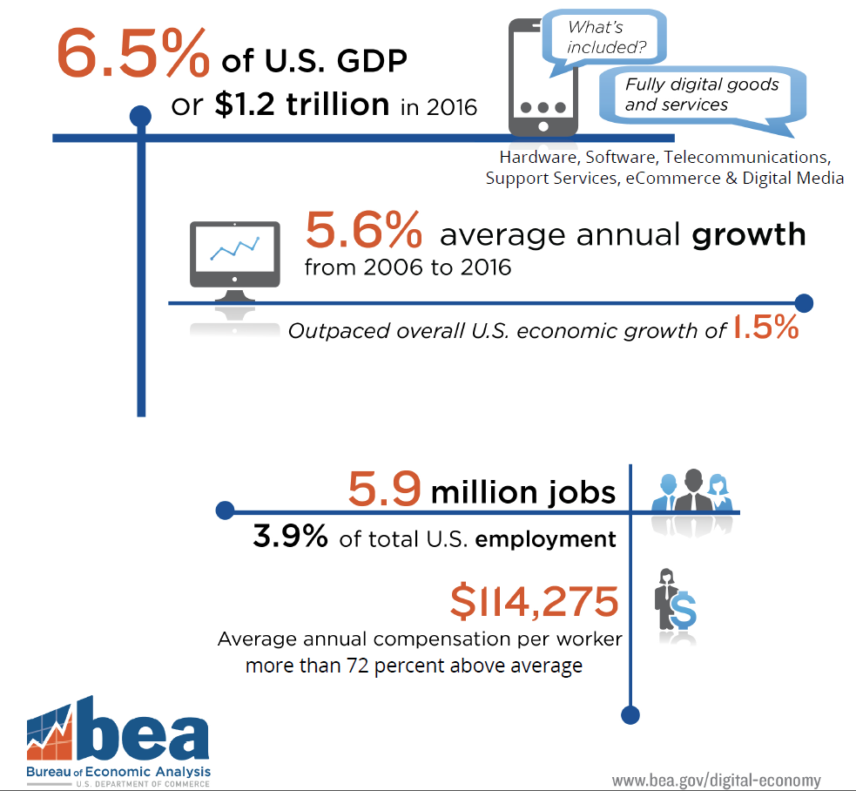

Slide 13
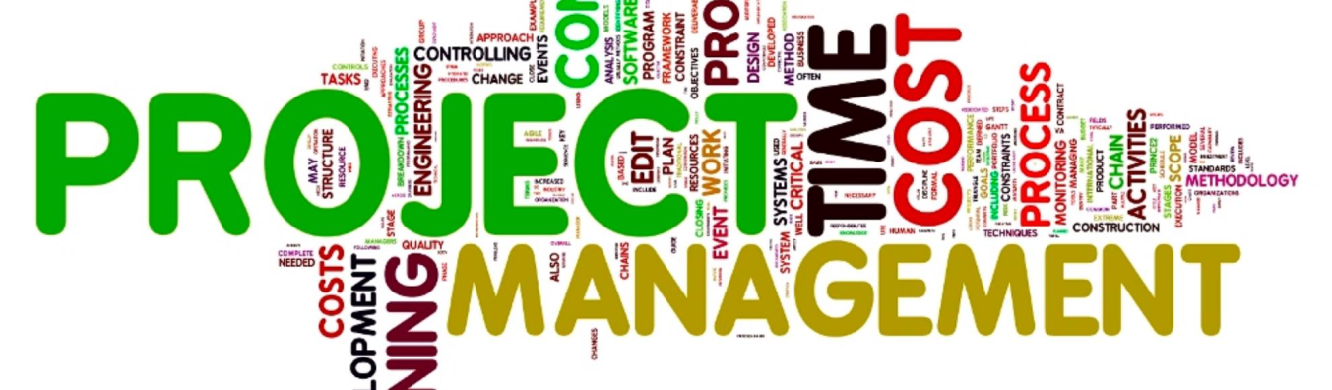
What are some typical “IT Projects?” What does a Project Manager do?

Slide 14
What are some typical “IT Projects?”
Development of new software or enhancement of existing systems to meet changing organizational goals
Deployment of new software across an organization and user training
Upgrading of new workstations/OS and user training
Upgrading of infrastructure: servers, network switches / routers / architecture to improve performance and workflow (not your job but it will affect you)
Notes:
75% of all software development dollars are spent maintaining existing programs: adding function, changing processes—both technical and business side, and a little bit on fixing bugs.

Slide 15

What does a Project Manager do?
PM ensures the project meets its goal, on time, within budget.
A project is a “collaborative work, carefully planned, to achieve a particular task or goal.” …that’s the ideal…then you solve problems
Triple Constraint, Project Management Triangle, Iron Triangle
Scope = Time × Resources
Notes:
Why are there project managers? Because things go wrong.
It is easy to bring any project in successfully without regard to one side of the triangle.
On time (budgeted work hours and scheduled calendar delivery) & on budget (cost & resources) is easy without regard to Scope & Quality (it may or may be complete, it may or may not work).
Increased Scope (called Scope Creep or Feature Creep) can be handled with either unlimited resources or unlimited time.
Budget cuts are handled with more time or less scope.
Accelerated schedules are handled with more resource (usually known as evenings and weekends) or less scope (usually unknown as in “What do you mean less scope? We have to have it all and more!”).
Project Managers exist to solve problems. If everything went according to that careful plan, they would be called Project Planners. Project Managers have jobs because things go wrong and the future cannot be predicted with great accuracy.
Brook’s Law was coined by Fred Brooks in his 1975 book The Mythical Man-Month. A copy is in the Seneca library.
The law: "adding manpower to a late software project makes it later".
Ramp up time. Bring a new person up to speed slows down the others.
Communication is an n-squared problem. Adding people, adds comm channels between other people & groups.
Limited divisibility of tasks: Why can’t you just get 9 women and make a baby in one month?
Google: Project Management Triangle (called also Triple Constraint or the Iron Triangle)
Google: dilbert project management
http://dilbert.com/search_results?terms=project
http://dilbert.com/search_results?terms=project+management
http://dilbert.com/search_results?terms=Future
http://dilbert.com/search_results?terms=scope
http://dilbert.com/search_results?page=2&terms=schedule
http://dilbert.com/search_results?terms=add+people
Image from https://programsuccess.wordpress.com/2011/05/02/scope-time-and-cost-managing-the-triple-constraint/

Slide 16
What does a Project Manager do? (Cont’d)
Project Management is the “application of knowledge, skills, tools, and techniques to project activities in order to meet project requirements” www.pmi.org web site PMBOK Guide
What does a Project Manager know?
Must have general knowledge of management and human communication and collaboration.
Must have particular knowledge of the project discipline (you can’t manage an IT project unless you understand IT and software development).
Notes:
A project manager knows a lot about one aspect of the project and at least a little about everything.

Slide 17
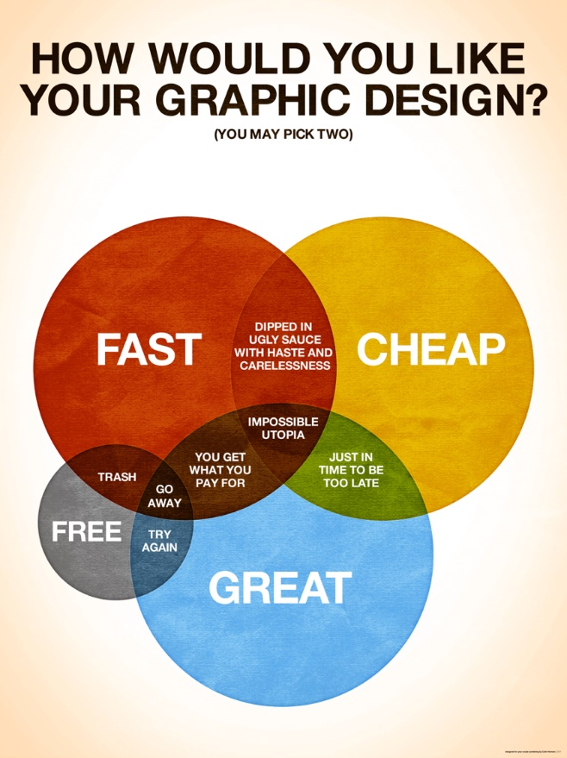
Good Cheap Fast
Pick Two
Notes:
Good Fast Cheap. Pick two.
Graphic from www.colinharman.com
Animated gif from http://missingcloud.com/gif/GoodCheapFast_MissingCloud_.gif
https://www.business.com/articles/fast-good-cheap-pick-three/
https://berkonomics.com/?p=2437
Good – Fast – Cheap are similar to Scope – Time – Resources in the PM Triangle or triple constraint. All three are difficult to achieve.
PMs have a problem: Computer hardware has steadily become better, faster, and cheaper for over 60 years. So have telecommunications. Compare your first PC with, if you are old enough, an analog modem card to the machine you have now with a built in 1Gb network port. Moore’s Law: computing power of Integrated Circuits doubles every ~18 months at no increase in cost per IC. In 1946 six brilliant young women programmed the first all-electronic, programmable computer, the ENIAC. The $1 of computational power available from Amazon Web Services today would have cost $1 trillion seventy years ago or ~$70 billion in 1946 dollars. The ENIAC project cost ~half a million dollars in 1946. Today, ENIAC's same computational power is used in greeting cards that play you a tune. Imagine the reaction if Time magazine, in its cover story about the ENIAC, had predicted: seventy years in the future, millions of hand-held, self-powered ENIACs will be bought for a few dollars at the corner store, used for 30 seconds and thrown away. No one would have believed you.
The ENIAC occupied 1,800 square feet and weighed more than 25 tons; it could execute 5,000 addition/multiplication instructions per second or 500 FLOPS or 0.0000005 GFLOPS The iPhone 6 is 123cm-square, weighs 4.55 ounces, and does 25 billion instructions per second. Or 6B FLOPS / 6GFLOPS. iPhone 7 runs >250 GFLOPS
In 1946, ENIAC, the first (nonsuper) computer, processed about 500 FLOPS. Today’s supers crunch petaFLOPS—or 1,000 trillion. https://pages.experts-exchange.com/processing-power-compared
https://aiimpacts.org/trends-in-the-cost-of-computing/ (about 12 orders of magnitude difference between 1946 and 2007, i.e. a trillion) estimate FLOPS grow by an order of magnitude every 7.7 years or 1 FLOP in 1946 = 9.35B in 2018
http://blogs.luc.edu/itshelpdesk/2013/02/07/the-history-of-processing-power/
http://money.cnn.com/interactive/technology/computing-power-timeline/
https://www.popsci.com/supercomputers-then-and-now http://allthatsinteresting.com/first-computer
https://technical.ly/philly/2011/02/15/eniac-10-things-you-should-know-about-the-original-modern-super-computer-65-years-later/ https://www.huffingtonpost.ca/entry/watson-scientific-computing-lab_n_2592670
Looking backward at hardware development sets expectations when looking forward to software development. But software does not obey Moore's Law. Software is made by people and people have not become many orders of magnitude faster, better, or cheaper in the last 7 decades. There is no economy of scale when creating software as there is when producing microchips. Yes, software tools are better now than the ones invented by those 6 women programmers (binary trees, sorting, breakpoints for debugging, and the foundational concepts for programming languages and compilers). But software cannot meet the same expectations clients have come to expect from their hardware. Microchips are made from silicon, software applications are made from ideas.
https://ee.stanford.edu/~hellman/opinion/moore.html
There's much more about women in programming, see https://vimeo.com/107667129 and http://eniacprogrammers.org/
https://en.wikipedia.org/wiki/ENIAC and https://en.wikipedia.org/wiki/Betty_Holberton
http://www.nytimes.com/2001/12/17/business/frances-e-holberton-84-early-computer-programmer.html
http://fortune.com/2014/09/18/walter-isaacson-the-women-of-eniac/
https://iq.intel.com/how-female-eniac-programmers-pioneered-the-software-industry/
http://hopl.info/showlanguage.prx?exp=5442
http://www.cbi.umn.edu/iterations/norberg.pdf

Slide 18
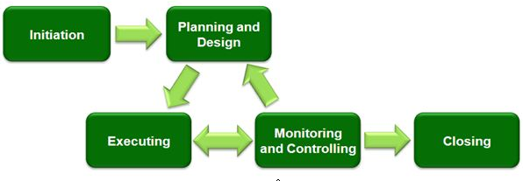
Project Management Process Groups
Notes:
These processes can occur multiple times within a project: at each major phase/stage or sub-project
Initiation
Project Level:
Sponsor defines project objectives, agrees to scope, and grants authority to the project manager.
The sponsor is the client, customer, senior management of the company.
Sub-Project or Phase/Stage Level:
Project Manager decides order of sub-projects/phases, aligns resources and stakeholders.
The sponsor/acceptor can be the client’s Business Analyst, Division Director, or Dept. manager depending on scope of work.
Planning
Project Manager determines scope, work breakdown structure.
A work breakdown structure is a key project deliverable that organizes the team's work into manageable sections.
https://en.wikipedia.org/wiki/Work_breakdown_structure
Executing
Puts the project plan into motion and performs the work of the project.
Controlling
Measures the performance of the executing activities and compares the results with the project plan.
Note these middle three processes are iterative. This is where a PM’s skills at problem solving and leadership are heavily used.
Closing
Documents the formal acceptance of the product at this phase and brings all aspects of the phase to a close.
Lessons Learned are documented: how to repeat success, how to avoid failures.

Slide 19
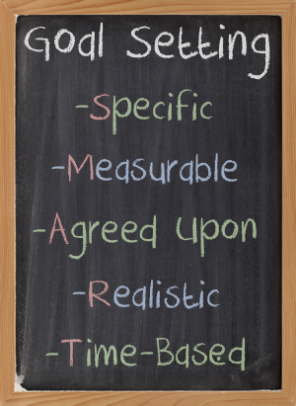
S.M.A.R.T. Goals for each Process Group
Ensure everyone knows what they should do
Set SMART goals
Notes:
This is a business standard for managing people on your team. It is how to tell people what is expected.
It is also your checklist to ensure your manager is giving you achievable goals before you accept them.

Slide 20
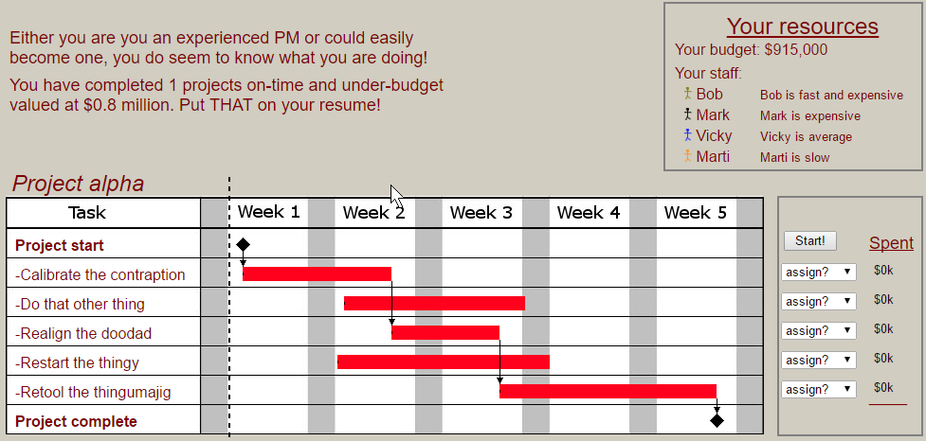
PM test at http://thatpmgame.com/
Notes:
Scope – Time – Resources in the PM Triangle or triple constraint.
http://thatpmgame.com/
Plan by putting available resources on the Gantt chart to complete tasks on time and on budget.
This Gantt chart shows what tasks are prerequisites to the start of next tasks, i.e. schedule dependencies.
More on WBS and Gantt charts in the Notes slides below.

Slide 21

Advantages of Project Management & Project Management Certification

Slide 22
Advantages of Project Management
Better control of financial, physical, and human resources
Shorter development times
Better internal coordination
Lower overall costs
Improved productivity
Higher worker morale
Higher customer satisfaction
Project Management is the fastest growing job category today!

Slide 23
Project Manager Professional (PMP)
Project Management is a profession and project managers must follow a Code of Ethics.
Project Management Institute provides training and certification. (www.pmi.org)
Seneca College is a registered education provider (R.E.P) of PMI.
Notes:
In order to gain PMP certification you must pass the exams and agree to the code of ethics.
The number of people adding PMP to their resume is increasing quickly. Consider adding it to yours.

Slide 24
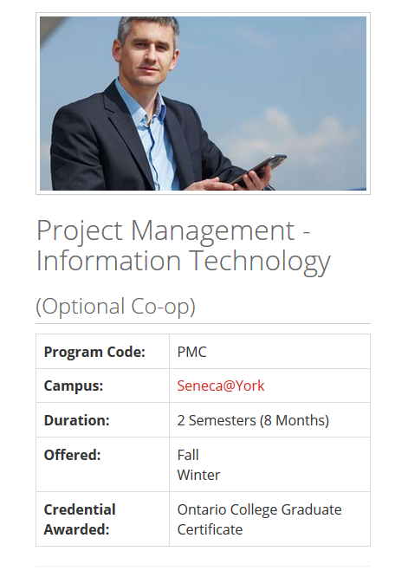
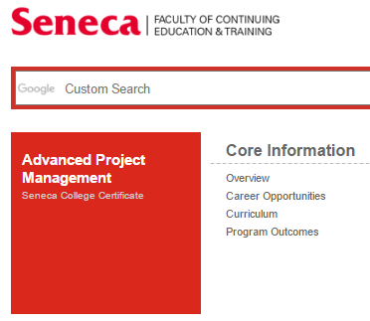
Project Management Certification at Seneca College
Notes:
URLs linked to images.

Slide 25
Notes
You will need these for today's activity.

Slide 26

Initiation
Initiation
Typically a company has a problem and defines a plan to solve the problem which is approved by management.
The Plan is a very “high-level” plan which defines the objectives to be achieved.
And typically grants authority to hire a Project Manager.

Slide 27

Planning
Project Scope: "The work needed to deliver a product, service, or result with the specified features and functions."
The Project Manager:
Ensures the project's objectives (business results and solutions to problems) are realistic and achievable.
Consults with stakeholders to define the scope of the project. The stakeholders of a project are typically: Customers, Users, Support Staff, and Upper Management.
Documents the scope of the project so all stakeholders fully understand the work to be done (and not done).
Notes:
https://en.wikipedia.org/wiki/Scope_(project_management)
Correctly defining the Scope leads to:
Ability to break the work done into concrete steps.
Understand the total cost of the project.
Tender contracts to complete the project.
Assign responsibility for key components.

Slide 28
Failure to define the project scope and taking into account all stakeholders, can lead to miss-defining the project and failure to complete the project
www.pmi.org web site PMBOK Guide

Slide 29
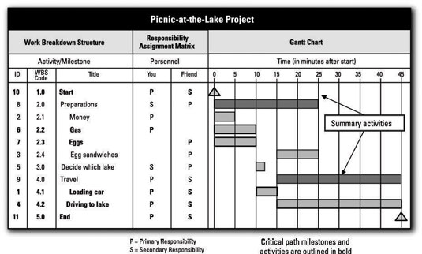
Planning – Work Breakdown Schedule (WBS)
WBS breaks the project into tasks with costs or estimated hours producing measurable deliverables.
A Gantt Chart gives the overall timeline for work-packages to be assigned to people or technical roles.
Notes:
http://www.dummies.com/careers/project-management/4-ways-to-display-your-projects-schedule/#slide-3
https://en.wikipedia.org/wiki/Work_breakdown_structure
A WBS is not an exhaustive list of work. It is instead a comprehensive classification of project scope.
A WBS is neither a project plan, a schedule, nor a chronological listing. It specifies what will be done, not how or when.
Gantt charts and Critical Paths address who, how, and when tasks are completed.
General rule of WBS tasks is the 8/80 rule. A task's work can be accomplished in 8 hours and not more than 80 hours or 1 day to two weeks.
A work package at the activity level is a task that:
can be realistically and confidently estimated;
makes no sense practically to break down any further;
produces a deliverable which is measurable; and
forms a unique package of work which can be assigned to a known person, a technical role, outsourced, or contracted out.
Tasks are acquisition of hardware, creation of software, and deployment/installation activities; these are all measurable deliverables.
A person-month is 120 – 150 hours, that is billable or task productive hours. It takes into account statutory holidays and administrative time.
https://en.wikipedia.org/wiki/Gantt_chart
A Gantt chart should also show what tasks are prerequisites to the start of next tasks, i.e. schedule dependencies.
A similar technique is using the Critical Path Method to construct a model of the project that includes the following:
A list of all activities required to complete the project (typically categorized within a work breakdown structure),
The time (duration) that each activity will take to complete,
The dependencies between the activities and,
Logical end points such as milestones or deliverable items.
This gives greater granularity in scheduling overlapping non-dependent activities, which set of dependent activities require the longest timelines, and where the schedule might be "crashed" by shifting more resources towards the completion of an activity.
https://en.wikipedia.org/wiki/Critical_path_method

Slide 30

Executing
It happens after approval of the timeline and an understanding of the work to be completed.
The project manager can estimate the total cost of the project. After management approves the project budget, the Project Manager tenders, contracts, hires internal or external workers to complete the required jobs.
The jobs are monitored to ensure that they are finished on time.
Adjustments will need to be made.

Slide 31

Controlling
Once the project is under way, the Project Manager must continually measure the performance of all activities and compare the results with the project plan.
Potential problems can be identified in a timely manner and corrective action taken, when necessary, to control the execution of the project.
Monitoring performance: Where are we now?
Monitoring variables: What variables are affecting the scope, cost and timeline of the project? – compared to “where we should be”
Identifying corrective actions: How can we get back on track?

Slide 32
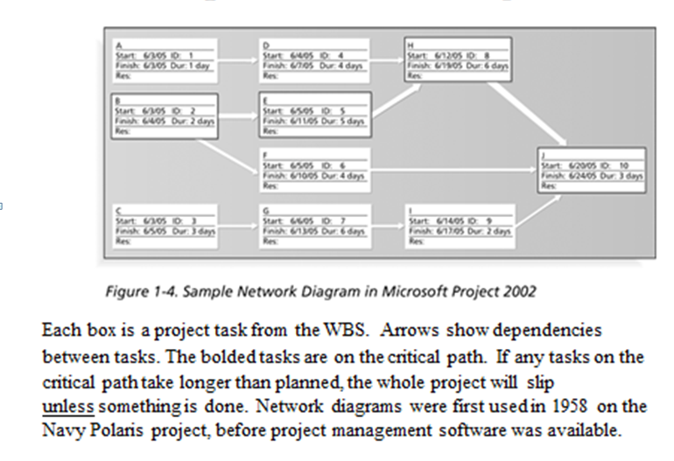
Controlling (Cont’d)
Today, mostly Software is used to control projects.
There is specialized software for small, medium and large projects.
The software here shows the “critical path.”
Notes:
http://www.dummies.com/software/microsoft-office/project/10-golden-rules-project-management/

Slide 33

Closing
Documents the formal acceptance of the project’s product and brings all aspects of the project to a close.
Closing includes the formal acceptance of the project and the ending thereof. Administrative activities include the archiving of the files and documenting lessons learned.
This process group consists of:
Contract closure: Complete and settle each contract (including the resolution of any open items) and close each contract applicable to the project or project's phase/stage.
Project closure: Finalize all activities across all of the process groups to formally close the project or project's phase/stage.
Post Implementation Review: This is a vital phase of the project for the project team to learn from experiences and apply to future projects. Normally a Post Implementation Review consists of looking at things that went well and analyzing things that went badly on the project to come up with lessons learned.

Slide 34
Why there is a need for Project Management?
Project Scope: "The work that needs to be accomplished to deliver a product, service, or result with the specified features and functions."
Top 5 Reasons for Project Management http://sambit-daspatnaik.blogspot.ca/2012/10/top-5-reasons-why-we-need-project.html:
deliver within scope, on time, within budget
deliver with quality
ensure productivity
prevent re-work
avoid blame gaming
Notes:
https://en.wikipedia.org/wiki/Scope_(project_management)
Using sound project management techniques and processes will give you a higher likelihood that your project will be completed on time, within budget and to an acceptable level of quality.
1. Are you going to manage scope or deal with cost and deadline overruns caused by doing more work than your budget covers?
A project's Scope statement defines and controls what is and, potentially, what is not included in the project.
2. Are you going to build quality into your process or fix problems later when they will be more costly to resolve?
3. Are you going to communicate proactively or deal with conflict and uncertainty caused by a lack of project information?
4. Your project will face potential risks. Do you want to try to resolve them before they happen or wait until the problems arise?
5. Your project is going to face issues. Do you want to proactively resolve them or figure them out as you go?
http://www.tensteppm.com/open/A1ValueofPM.html
Top 5 Reasons why we need Project Management Processes
We all follow Project Management processes in our projects. Mostly, they are tailored to meet the requirements of the project. Some projects need tighter control and more stringent processes that might have been mandated in the contract, while some need processes sufficient to self manage and execute the project to meet the deadlines and quality standards. Whatever be the reasons, if we don’t follow certain processes, it will definitely jeopardize the project.
Here are top 5 reasons why we need to follow processes:
1) To meet the deadlines: This is first and foremost. Many times, there are delays in deploying the project at the client’s site because there is no process defined for uploading the software or patches in the customer’s environment. Important steps like build packaging, testing the smooth installation are left out if these are not mentioned in a standard to do checklist. This can cause the team to run around for last minute activities that may result in more problems identified at the last minute. This inadvertently delays the final delivery of the project or product to the customer.
2) To maintain the right quality: If certain processes or tasks are missed, a high number of defects will be raised at the customer end. Some of them can be precarious such as an interactive website not opening at all for the end user (Obamacare launch), or payments being incorrectly processed (Target Canada).
3) To ensure productivity: If processes are not maintained and followed, it can result in tasks or activities being identified in an ad hoc manner with managers expecting team to stay late and complete work that could have been otherwise planned well in advance. The team will eventually burn out.
4) To prevent re-work: It costs $1 to create a business requirement, it costs $100+ to add it after Go Live.
Many a times, due to lack of process, the communication between team members and managers is less than adequate. Assumptions are made. Tasks are completed with a different set of objectives in mind. E.g., Software developer ending up writing code that result in performance issues in a mission critical product. This can cause the customer to wait for a long time for say, a financial transaction to happen. The team then ends up fixing the problem in the next build or release cycle causing more re-work.
5) To avoid blame gaming: All the above points lead to one major effect….Playing the blame game. Each team puts the blame to the previous team, or puts the blame of bad quality to production team. And this goes on in a vicious circle. Add political angle to it, and the project goes for a six. While all this could have been easily avoided by simply following right processes.
Japanese maxim: Fix the problem, not the blame.
(http://sambit-daspatnaik.blogspot.ca/2012/10/top-5-reasons-why-we-need-project.html)
https://en.wikipedia.org/wiki/Project_management
https://www.wrike.com/project-management-guide/methodologies/

